Slide 1
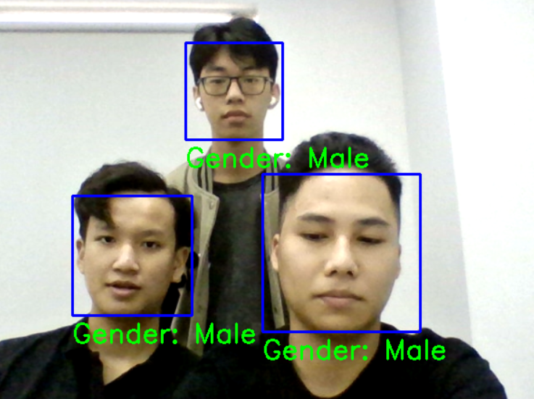
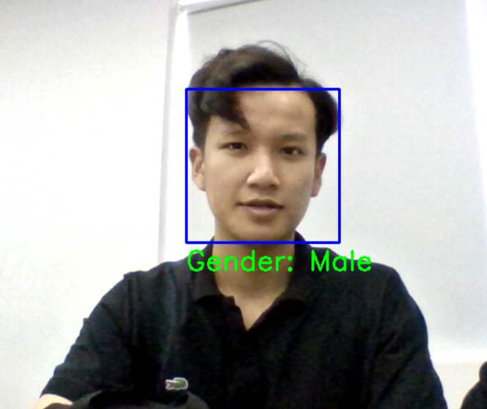
Project: Determine Gender Based On Photos

Slide 2
Agenda
Introduction
Exploratory Data Analysis
Build Model
Evaluation
Conclusion

Slide 3
Introduction
Introduce Group
Team 1:
+ Hoang Quoc Trung – SE151140 (Leader)
+ Nguyen Hung Thinh – SE151079
Introduce Model
Model to identify gender through face image.
We use and test CNN models, specifically Transfer Learning models (VGG 16, Resnet 50, Efficientnet B0, Inception V3, Mobilenet, Xception) and choose the VGG 16 model that best applies to the project. and achieved an accuracy of 98.11% on the test set dataset.
Dataset
Using CelebA's data available on Kaggle.
Data has been labeled.
This dataset is about 200k images of male and female faces with a common size of 218x178, mostly European faces.

Slide 4
Introduction
Why Did We Choose This Project ?
Widely used in daily life .
Extract a lot of user information such as :
Gender.
Age.
Emotion.
Health status.
Ethnic.
Support and economic boost :
Attendance systems.
Automated trading systems.
Smart advertising through gender.

Slide 5
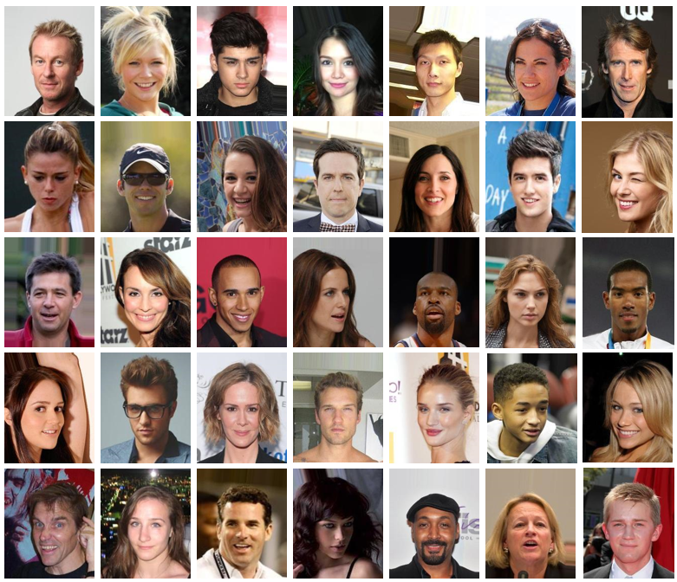
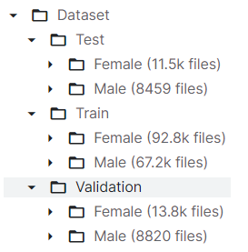
Exploratory Data Analysis
Data Analysis
The size of the pictures is 218x178.
Mostly European faces.
Image file format is JPG.

Slide 6
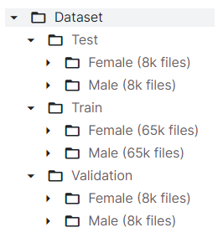
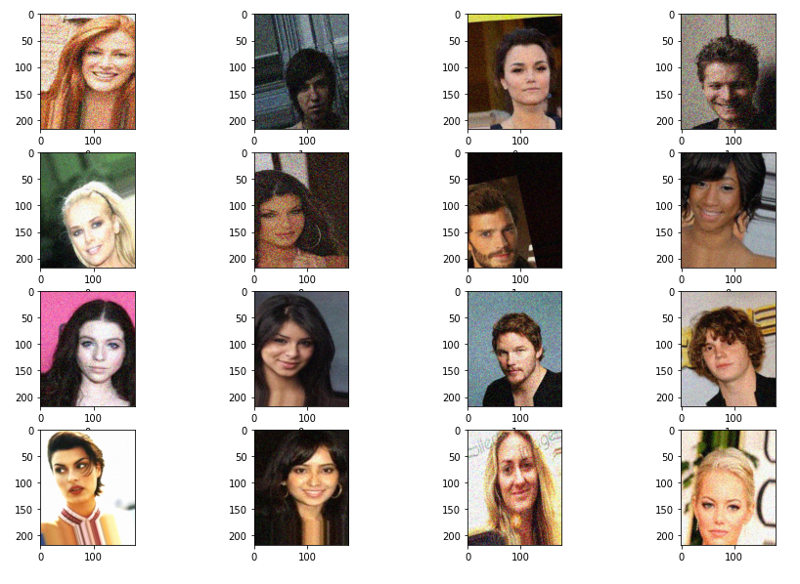
Exploratory Data Analysis
Data Processing
Data argument: rotation, shear, zoom, horizontal flip, brightness, add noise, rescale, shuffle.
Balance the amount of data between Female and Male

Slide 7

Build Model
Investigate Some Models That Can Be Applied To The Problem
VGG 16
Inception V3
MobileNet
Xception
Resnet 50
EfficientNet B0
SVM + HOG

Slide 8
Build Model
Test Deep Learning Models And Evaluate Them
Model Epoch | VGG 16 | Inception V3 | Resnet 50 | Efficiennet B0 | Xception | MobileNet
20 | 0.976 | 0.918 | 0.77 | 0.51 | 0.936 | 0.972
Accuracy on test set of deep learning models (1 epoch / 1 hour)

Slide 9
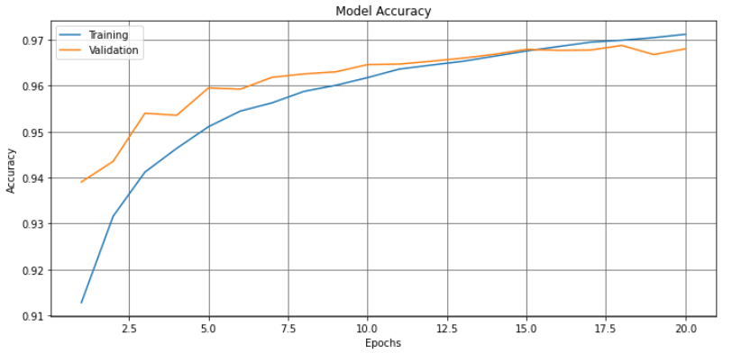
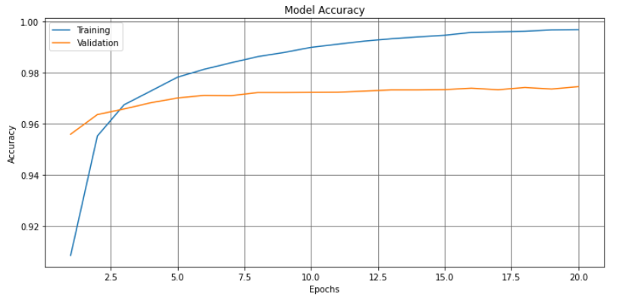
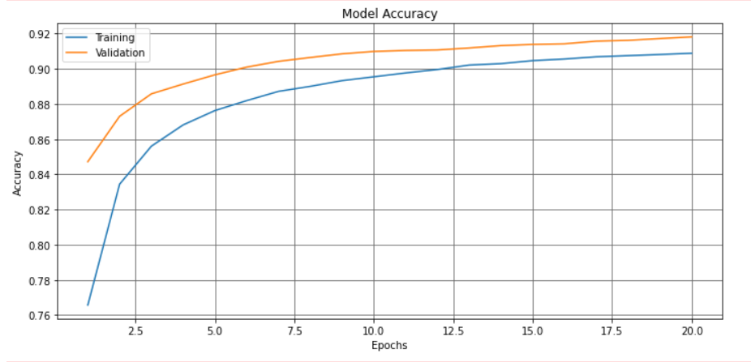
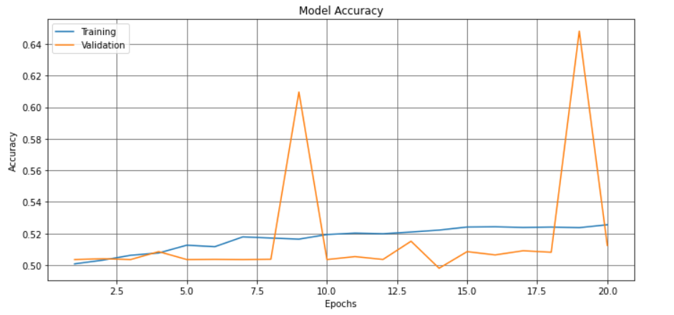
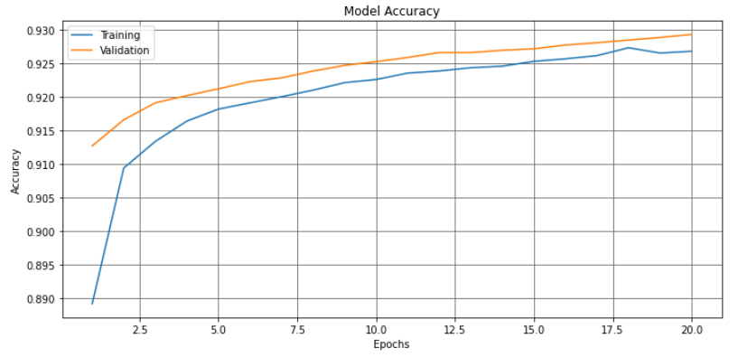
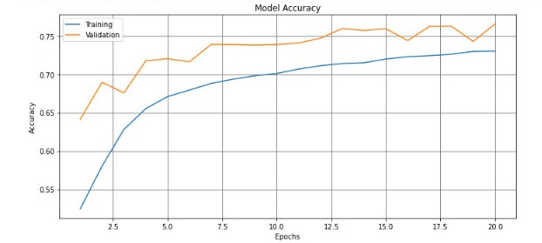
VGG 16
Mobilenet
Inception V3
Efficientnet B0
Xception
Resnet 50

Slide 10
Build Model
Some Advantages Of The Methods
VGG 16: Simple, small number of parameters, few layers, better model accuracy.
Inception V3 : The point worth noting in this version is Factorization (explanation), Combining multiple filters of different sizes into the same block increases computational speed. This method has the effect of helping to extract a variety of features on cognitive regions of different sizes, extracting more information on an image.
EfficientNet B0: This model offers a new approach to scale ConvNet model to get better results with less number of params, by Depth Scaling, Width Scaling, Resolution Scaling.

Slide 11
Build Model
Some Advantages Of The Methods
MobileNet : It helps to reduce the number of parameters to a few million parameters but still maintain good accuracy, thanks to the use of a mechanism called Depthwise Separable Convolutions.
Resnet : Previous architectures often improve accuracy by increasing the depth of the CNN network. But experiments show that up to a certain depth threshold, the accuracy of the model will saturate and even backfire and make the model less accurate. When traversing too many layers of depth can cause original information to be lost, Microsoft researchers solved this problem on ResNet by using a shortcut connection. Skip connections help keep information from being lost by connecting from the earlier earlier layer to the later layer and skipping some intermediate layers.

Slide 12
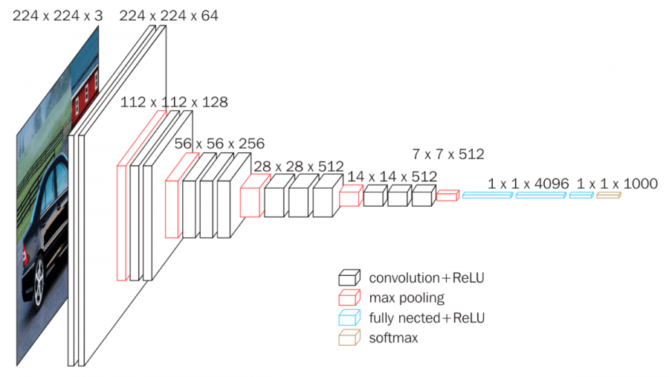
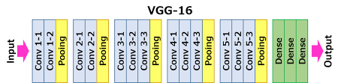
Build Model
Training Model VGG - 16
According to observation and evaluation, model VGG - 16 is the best.

Slide 13
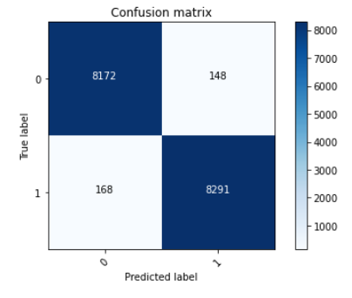
Evaluation
Training Model VGG - 16
After training with 60 epochs, evaluating the model VGG - 16 out of 16779 images belonging to 2 classes: The
accuracy is 0.981167%.
The model can be seen very well.
Total wrong pictures 316 out of 16779
pictures.

Slide 14
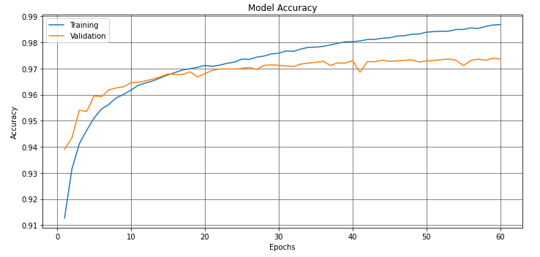
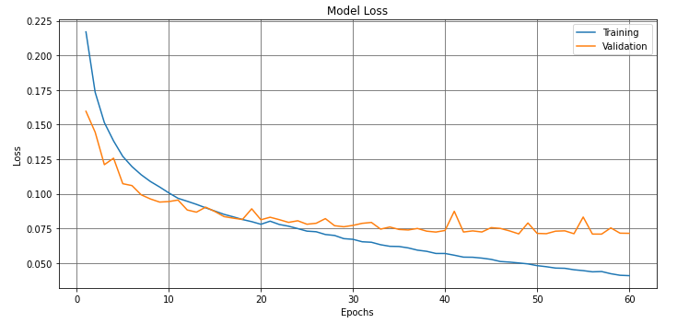
Evaluation
Accuracy And Loss Of Data Train Set And Data Validation Set

Slide 15
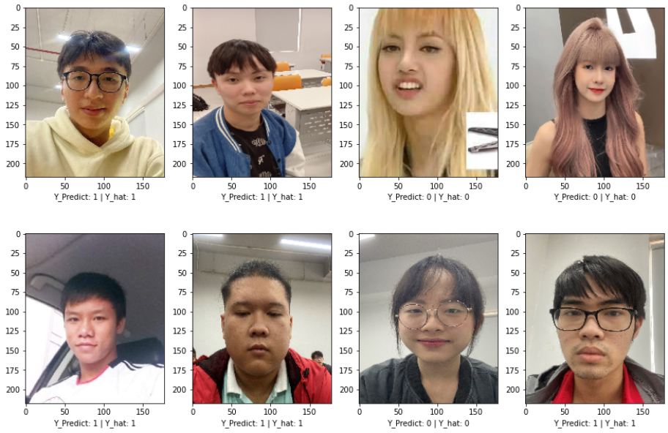
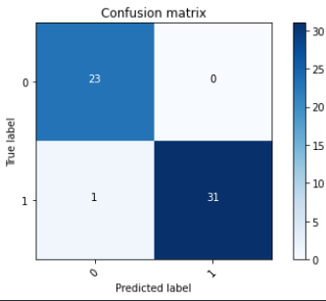
Evaluation
Test On Asian Face

Slide 16
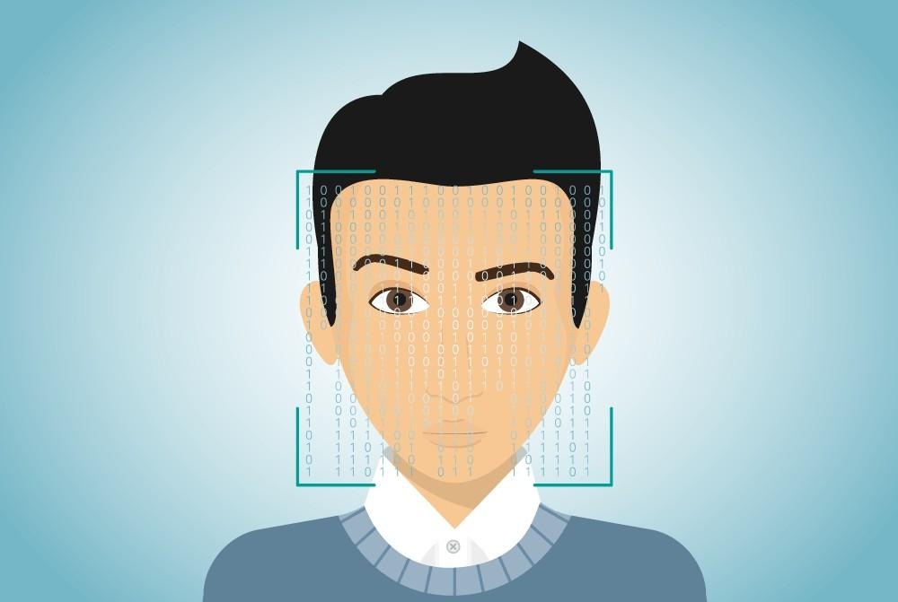
Evaluation
Demo On Camera

Slide 17
Conclusion
Conclusion And Overview Of The Model
The model recognizes well when the face image is looking straight ahead, still not good for other face directions. Because the face data for the train is mostly straight-forward.
Accuracy for European faces is better than for Asian faces.
Opencv's face detection is not good, has not caught all the faces moving to the inclined directions.

Slide 18
Conclusion
The Next Development Directions
We will improve the face detection method with other models like (Yolo, MTCNN, etc) instead of using the built-in model supported by Open CV.
Collect more Asian face data for even greater accuracy.
Add some attributes to the model like age, facial expressions instead of gender recognition.
Further improved data to accurately predict faces at different angles.
Application: Smart advertising, extracting the user's gender and age through the camera to recommend suitable products for the user. Application in chatbot models to let the machine interact with users more effectively.

Slide 19



